Slide 1
WELCOME TO THE GEORGE H. BANNON GOLF PERFORMANCE CENTER
PLAY WELL

Slide 2
OUR MISSION
PROVIDE YOU THE KNOWLEDGE AND TOOLS REQUIRED TO DEVELOP, IMPROVE AND SUSTAIN YOUR SKILLS IN ORDER FOR YOU TO IMPROVE PERFORMANCE AND ACCOMPLISH YOUR GOALS AS A PLAYER

Slide 3
TPG GOLF COACHING SYSTEM BUILD YOUR BASE SKILLS

Slide 4
IMPROVING ON COURSE PERFORMANCE
Develop an effective 30-40 second pre-shot routine
No mechanical swing thoughts
Pick a target and be an athlete
Get your tee ball in play
Target score of 3 or less from 75 yards from green
Reduce number of 3 putt greens
Trust your process

Slide 5
HOW TO PRACTICE
BASE SKILLS
DRILLS/TRAINING AIDS/SETUP/FUNDAMENTALS (10-15%)
INCLUDES LEARNING NEW TECHNIQUE/MOTOR PATTERN
USE OF ALIGNMENT STICKS/TRAINING AIDS
REPETITIVE SHOTS WITH SAME CLUB
ADAPTIVE SKILLS (PICK A SHOT AND PLAY GOLF)
RANDOM TRAINING THAT REPLICATES WHAT WE EXPERIENCE ON THE GOLF COURSE (70%)
THE RANGE IS VERY PREDICABLE/STATIC BUT COURSE IS ALL ABOUT VARIATION AND ADAPTING TO CONDITIONS
VARYING SHOTS AND CLUB SELECTION
VARYING LIE AND DISTANCE
INCORPORATE FULL ROUTINE/PROCESS
PERFORMANCE SKILLS
PLAY FOR SCORE/SKILLS TEST (20%)

Slide 6
BRINGING THE NEW AGE
OF GOLF PERFORMANCE COACHING
TO PLAYERS OF ALL SKILL LEVEL
TPG GOLF IS A VETERAN OWNED SMALL BUSINESS FEATURED BY NBC NEWS AND THE NATIONAL WEEKLY TV SHOW “THE RACE 2020”

Slide 7
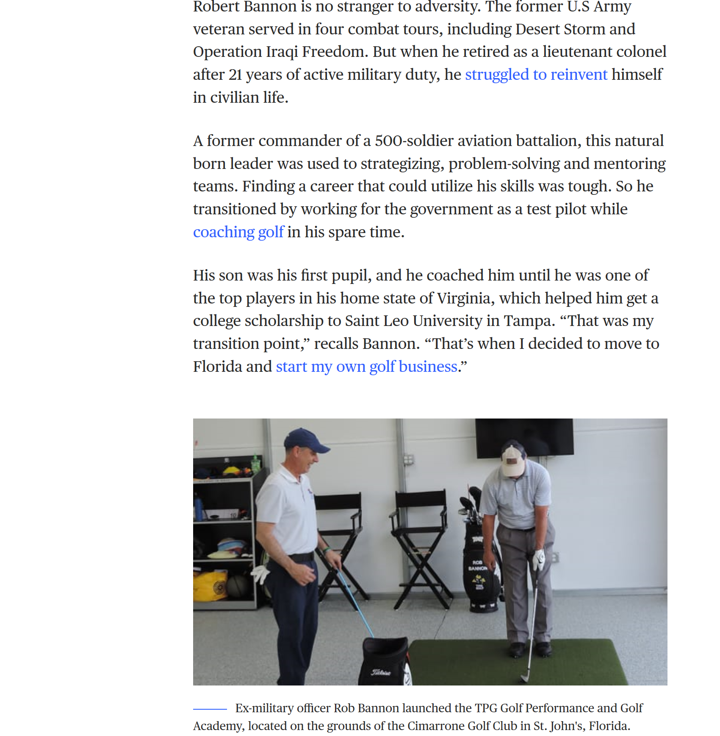

Slide 8
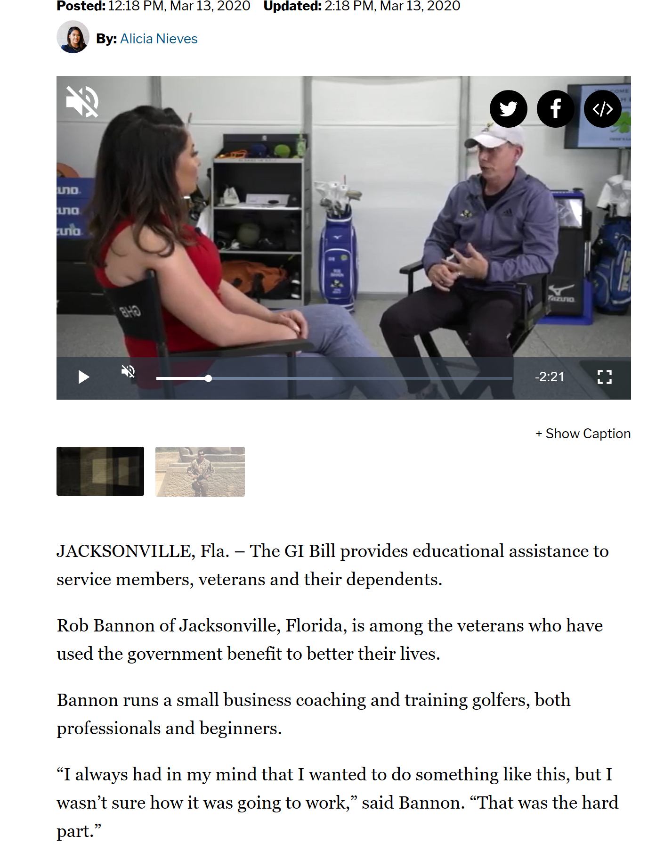

Slide 9
Your performance solution play well

